Slide 1


ACCIDENT PREDICTION AND PREVENTING SYSTEM USING DATA-DRIVEN MODELS
Guided by,
Dr.R.Nallakumar M.E, MBA, Ph.D.,
Associate Professor,
Department of Artificial Intelligence and Data Science,
Karpagam Institute of Technology,
Coimbatore.
Presented by,
S.LINKEDH(721220243028)
M.NATHISH(721220243035)
M.PRASANTH(721220243045)
K. SRIKANTH(721220243053)
Department of Artificial Intelligence and Data Science,
Karpagam Institute of Technology,
Coimbatore.

Slide 2
ABSTRACT
The "Accident Prediction and Prevention Using Data-Driven Models" project seeks to create a system that combines real-time and historical data to forecast the likelihood of accidents happening and to put preventative measures in place to lower the risk of accidents.
The project entails gathering and analyzing accident data, generating data-driven models, user-friendly and assessing the efficacy of preventive measures.
The project's scope can be implemented in a variety of industries where accidents are a major worry depending on the specific application and data that are available. The improvement of workplace and transportation system safety and accident reduction will result from the system's development.

Slide 3
EXISTING SYSTEM
PREDICTION MODELS:
The existing system for accident prediction utilizes various data-driven models, including algorithms like decision trees, random forests, support vector machines (SVM), and neural networks. These algorithms leverage historical accident data, along with relevant features such as road conditions, weather conditions, and driver behavior, to train predictive models.
The models can then generate insights and predictions regarding the likelihood of accidents, enabling proactive measures such as targeted enforcement, road maintenance, and public awareness campaigns to reduce the occurrence of accidents.
LIMITATIONS OF EXISTING SYSTEM
Data Quality
Feature Selection
Ethical Considerations
Model Interpretability

Slide 4
PROPOSED SYSTEM
The proposed work aims to analyze road accidents using machine learning, specifically by utilizing a combination of K-Nearest Neighbors (KNN) and Decision Trees algorithms.
The KNN (K-Nearest Neighbors) Algorithm helps to identify similar accidents based on their features, while the Decision Tree Algorithm helps to identify the most important features for predicting the accident outcome.
The combination of these two algorithms can improve the accuracy, robustness, interpretability, and flexibility of the model.
By analyzing accident data, the model can predict accident-prone areas and provide insights into the causes of accidents. The ultimate goal is to reduce the number of accidents and save lives on the roads.

Slide 5
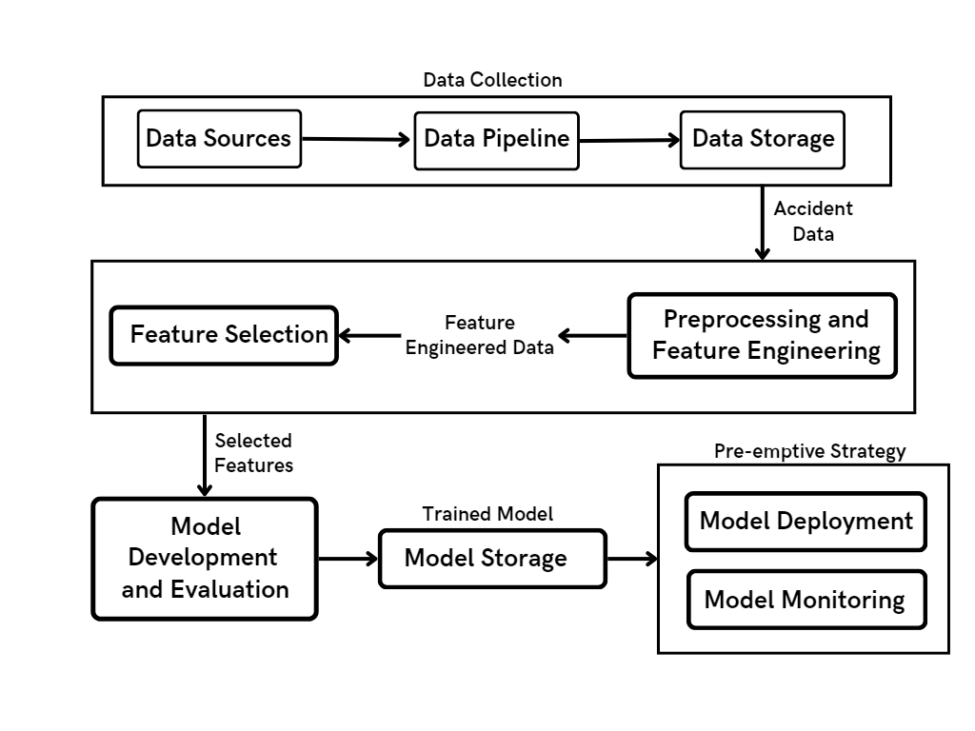
OVERALL ARCHITECTURE OF SYSTEM

Slide 6
LIST OF MODULE
Data collection module
(Module 1)
Data preprocessing and feature engineering module (Module 2)
Model development and evaluation module
(Module 3)
Deployment and monitoring module (Module 4)

Slide 7
DATA COLLECTION
The data collection module is responsible for gathering data from various sources such as public databases, traffic cameras, and sensors.
In order to obtain raw data and store it in a data pipeline, this module uses data extraction and ingestion techniques.
The data gathered may contain specifics about accidents as well as information about the weather, the state of the road, the volume of traffic, and the type of vehicles involved.

Slide 8
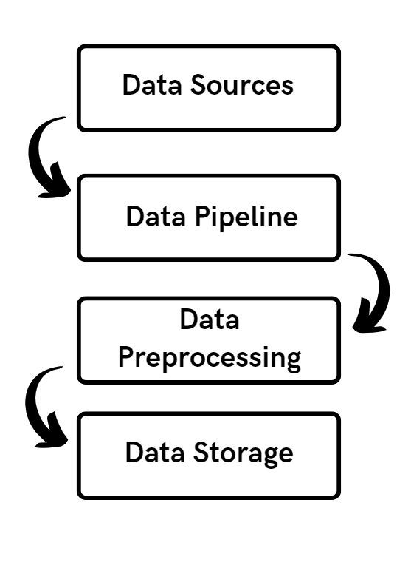
Data Flow Diagram for Data Collection Module

Slide 9
DATA PREPROCESSING AND FEATURE ENGINEERING
The data collection module is responsible for gathering data from various sources such as public databases, traffic cameras, and sensors.
In order to obtain raw data and store it in a data pipeline, this module uses data extraction and ingestion techniques.
The data gathered may contain specifics about accidents as well as information about the weather, the state of the road, the volume of traffic, and the type of vehicles involved.

Slide 10
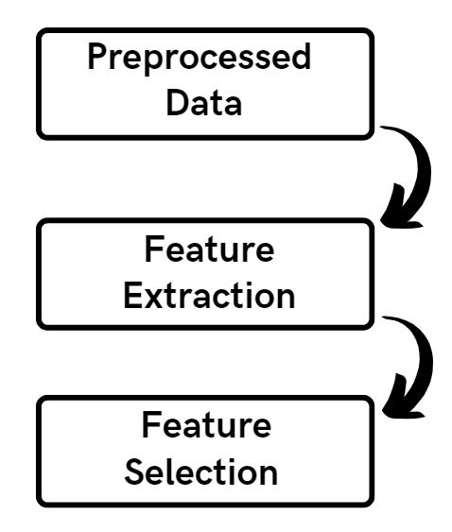
Data Flow Diagram for Data Preprocessing and Feature Engineering Module

Slide 11
MODEL DEVELOPMENT
A structured format for machine learning is created from raw data by the data preprocessing and feature engineering module.
To ensure quality and consistency, methods include scaling, normalization, and data cleansing.
For the purpose of predicting accidents, important variables including traffic flow, weather, and time of day are extracted.

Slide 12
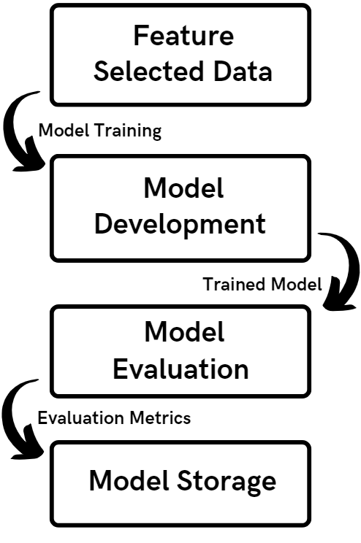
Data Flow Diagram for Model Development Module

Slide 13
DEPLOYMENT AND MONITORING
Deployment module involves implementing preemptive strategies based on the predictions of the machine learning models to prevent accidents before they occur.
Monitoring module continuously evaluates the effectiveness of the deployed preemptive strategies and collects feedback to improve their performance.
The output of this module is a system that can predict and prevent accidents in real-time, minimizing the risk of injuries and fatalities on the road.

Slide 14
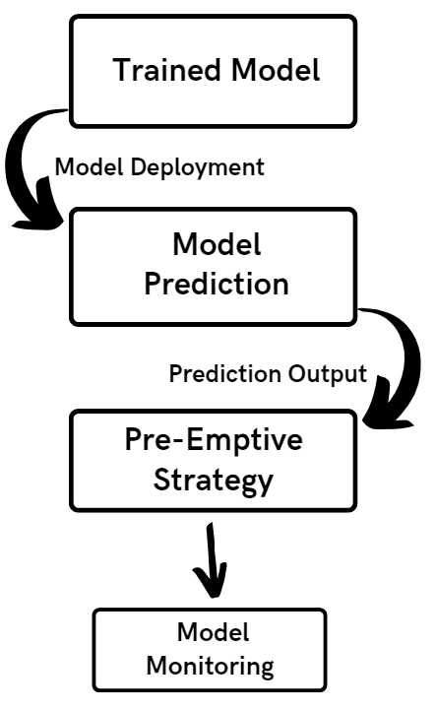
Data Flow Diagram for Data Preprocessing and Feature Engineering Module

Slide 15
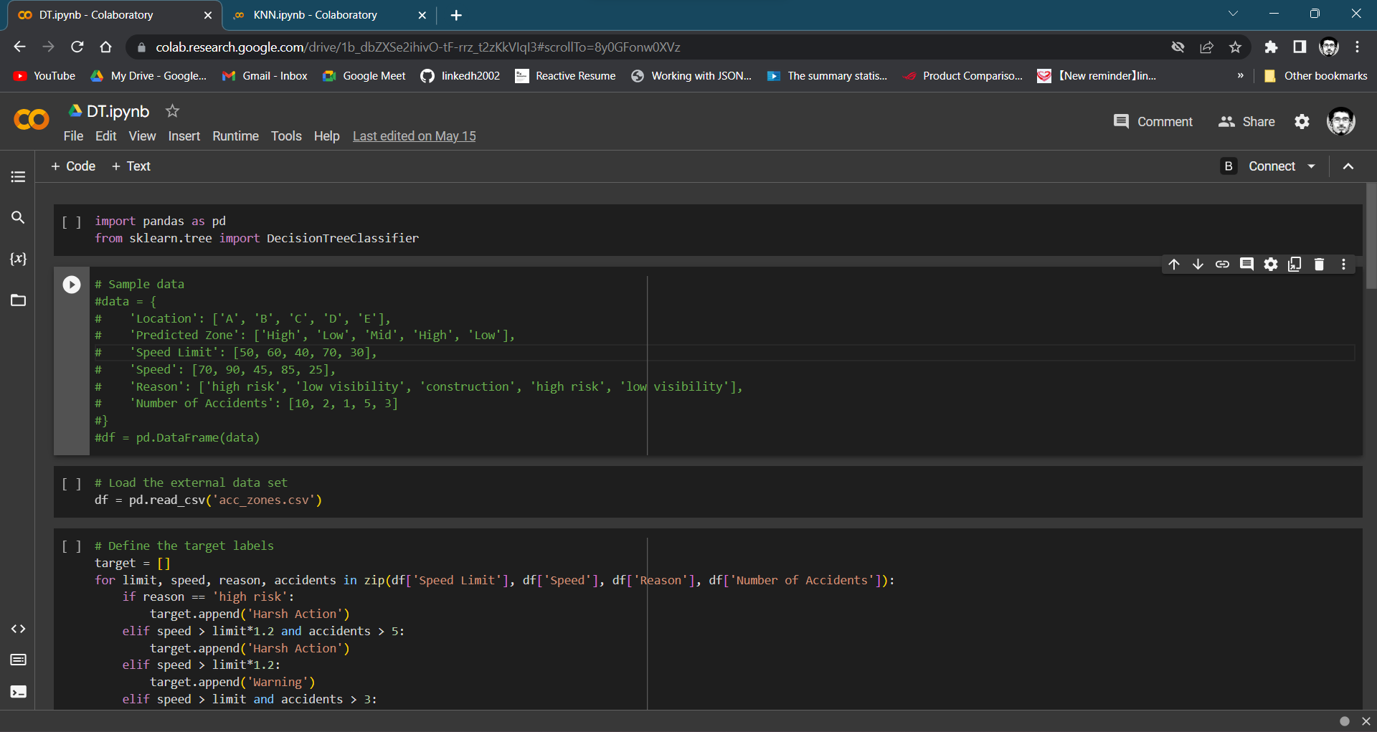
SAMPLE SOURCE CODE

Slide 16
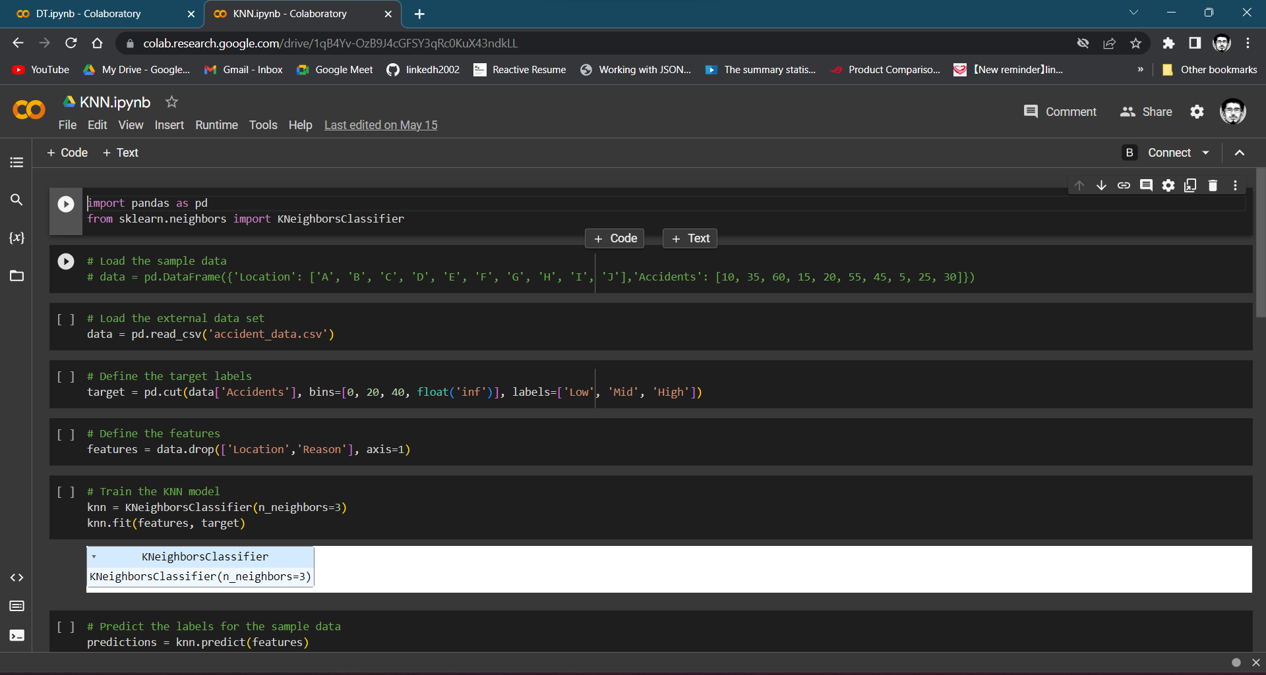
SAMPLE SOURCE CODE

Slide 17
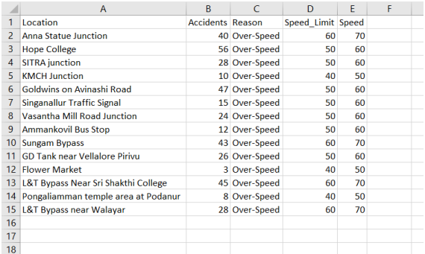
IMPLEMENTATION SCREENSHOTS
Input Dataset for Training the Model
The dataset includes location, speed limit, number of accidents, reason, and average speed features. Location is used to cluster zones, while speed limit and average speed provide speed-related insights. Number of accidents tracks accident frequency and severity, and reason identifies the causes of accidents.

Slide 18
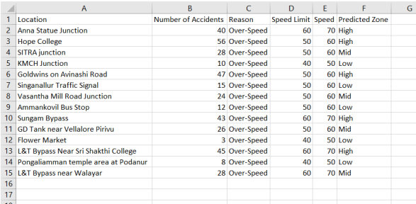
IMPLEMENTATION SCREENSHOTS
Clustered Location into Zones
The output CSV file generated by the KNN algorithm includes the predicted zones based on the clustering of accidents. Each zone is identified by a unique ID and is assigned based on the proximity of accidents in a particular location. The output also includes the features of each accident, such as the number of accidents and the reasons for the accidents.

Slide 19
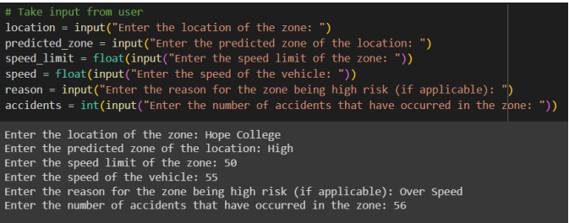
IMPLEMENTATION SCREENSHOTS
Taking Real Time Data from the Users or Sensors in Vehicle
Getting inputs for the accident prediction and prevention system can be done through various methods, such as user input through a mobile app or website, or sensors installed in the car. The sensors can collect data on the speed of the car, road conditions, and other factors that could potentially lead to an accident. This data can then be processed and used in the accident prediction and prevention system to alert the driver of potential hazards or to take preventative measures to avoid an accident.

Slide 20
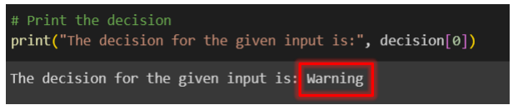
IMPLEMENTATION SCREENSHOTS
Prevention Action by Decision Tree
The final prevention methods in the accident prediction and prevention system can be presented to the user through various means, such as an alert system in the car or a notification on a mobile app. The system can provide recommendations to the driver to adjust their speed, take a different route, or avoid certain areas with high accident rates. Additionally, the system can provide information on the reasons for accidents in a particular area, allowing the driver to take appropriate precautions. The ultimate goal is to prevent accidents and promote safe driving habits.

Slide 21
REFERENCES
T. Deva Prakash, Nagaraju V, “Comparative Analysis using K - Nearest Neighbour with Artificial Neural Network to Improve Accuracy for Predicting Road Accidents”, 2022 International Conference on Edge Computing and Applications (ICECAA).
Mohammadreza Hosseinzadeh, Alireza Sadeghi, and Mohammad Mehdi Khosravi , “A Data-Driven Approach to Accident Prediction and Prevention”, IEEE Transactions on Intelligent Transportation Systems, 2022.
Rasika Vijithasena, Wikasitha Herath, “Data Visualization and Machine Learning Approach for Analyzing Severity of Road Accidents”, 2022 International Conference for Advancement in Technology (ICONAT) Goa, India. Jan 21-22, 2022.
Hossein Anisi, “Evaluation of the Cyber Security Risk Models (CSRM) in Cloud Computing”, Journal of Machines and Computing, vol.2, no.3, pp. 124-133, July 2022.
Wei Wang, Weiwei Zhang, and Xinbo Zhang, “A Deep Learning Model for Traffic Accident Prediction”, Transportation Research Part C: Emerging Technologies, 2021.

Slide 22
THANK YOU!

